Slide 1
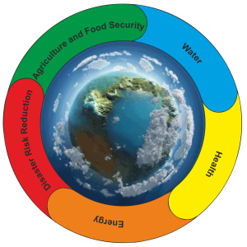

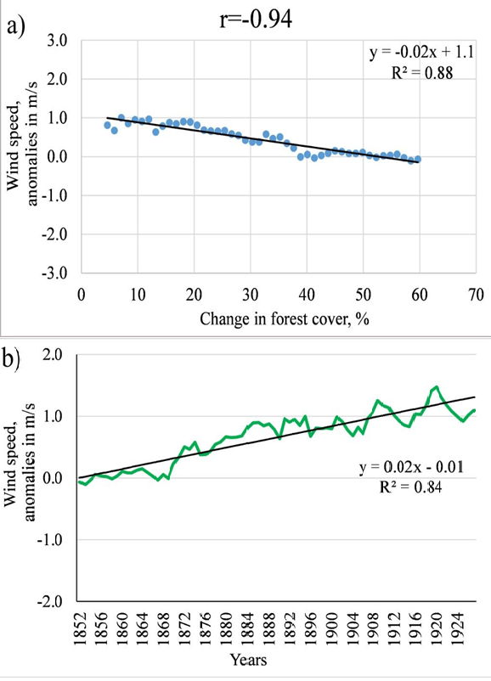
The influence of partial deforestation on surface wind speed
Larysa Pysarenko, Svitlana Krakovska, PhD, Sen. Res.
Ukrainian Hydrometeorological Institute of the State Emergency Service of Ukraine and the National Academy of Sciences of Ukraine, Ukraine
Introduction
Methods and Materials
Results and conclusions
It is known that canopy impacts climate characteristics via albedo, evaporation etc. Also, it affects wind speed through roughness and height. The forest influences the most via causing reduction in surface wind speed and provokes local circulation. Nowadays, against the backdrop of climate change which causes extreme weather events and quantitative redistribution of climate characteristics, the mankind has been facing the deforestation for the last several decades. The deforestation is one of the factors that increases the risks of dust storms, soil degradation, etc. through wind speed acceleration. These problems attract a lot of attention of the world community and the one of the last reports of IPCC was dedicated to the most urgent problems of land degradation and management taking into account climate change and concerning different regions of our planet [1]. Also much research deal with climate issues and there are many global climate projects, for example, the Coupled Model Intercomparison Project Phase 6 (CMIP 6) [2] the purpose of which is to observe, model and analyze climate change in the past, current state and for the future. One part of this project is the Land Use Model Intercomparison Project (LUMIP) [3] that refers to the past.
The purpose of the presented study is to assess the quantitative impact of partial deforestation on wind speed for the territory of Ukraine.
The aim of this experiment is to investigate the impact of partial deforestation with constant unchangeable anthropogenic impact via global climate models (GCM) for historical period 1850-1929. It is divided into two phases: 1) 1850-1899, defined as pre-industrial with gradual deforestation with a trend approximately 1%/year; 2) 1900-1929 with constant forest cover. Recent years a couple of publications have been published with results of analyzing only annual characteristics of air temperature and sum of precipitation on a global scale [4]. In our research data of retrospective modelling of 6 GCM were used that retrieved from [5]. They have different spatial resolution. For data analysis calculated the mean of wind speed for each month for base period 1850-1869 and found the difference (or anomaly) between a parameter in every month of the year and the corresponding month in the base period. For getting rid off the possible biases the obtained data series were smoothed by 5-year running mean and found correlations between deforestation and wind speed.
The obtained results have shown that all 6 GCMs demonstrated the increase of wind speed and negative correlations with mean and strong bond between forest cover reduction for all months. For the winter season, on the example of January, the correlations between deforestation and wind speed were -0.91…-0.4 in general, that causes the increase of wind speed with trend 0.1-0.2 m/s per 10 years or up to 1.2 m/s in general (Fig.2). For the spring season, the correlations for all GCMs were -0.95… -0.4 and with growth of wind speed with value 0.04-0.2 m/s per 10 years or up to 1.1 m/s. The strongest negative correlation and more significant changes (Fig.1) were found for GCM with more intense deforestation of 1.2-1.3%/year. For July correlations were within -0.97…-0.4 that provoked wind increase up to 0.02-0.2 m/s per 10 years or 1.0 m/s. Also, in autumn for October forest cover reduction triggered the growth of wind speed 0.04-0.3 m/s per 10 years (or up to 1.2 m/s) that is supported strong and average correlations -0.97…-0.4. So, all GCMs have confirmed that partial deforestation increases wind speed and consequently, will increase risks connected with dust storms, soil erosion etc.
Fig. 1. The correlation between a partial deforestation (%) and changes in wind speed (m/s) (a); the trend of wind speed (m/s) (b) for April, North Ukraine
Fig.2 The difference between mean wind speed (m/s) for 30-year period 1900-1929 after and 50-year period 1850-1899 during a partial deforestation for GCM 5 (а - January; b - April; c - July; d - October )
REFERENCES
1. IPCC: Special Report on Climate Change, Desertification, Land Degradation, Sustainable Land Management, Food Security,
and Greenhouse gas fluxes in Terrestrial Ecosystems. (2019.) Retrieved from: https://www.ipcc.ch/srccl/
2. CMIP Phase 6 (CMIP6). Retrieved from: https://www.wcrp-climate.org/wgcm-cmip/wgcm-cmip6
3.Lawrence D. M., Hurtt George C., Arneth A. et al. (2016). The Land Use Model Intercomparison Project (LUMIP) contribution to CMIP6: rationale and experimental design. Geosci. Model Dev., 9, pp. 2973–2998, https://doi.org/10.5194/gmd-9-2973-2016
4. Boysen L., Brovkin V., Pongratz J., et al. (2020). Global climate response to idealized deforestation in CMIP6 models. Biogeosciences, 17, pp. 5615–5638, https://doi.org/10.5194/bg-17-5615-2020
5. ESGF: WCRP Coupled Model Intercomparison Project. Retrieved from: https://esgf-node.llnl.gov/search/cmip6/

