Slide 1

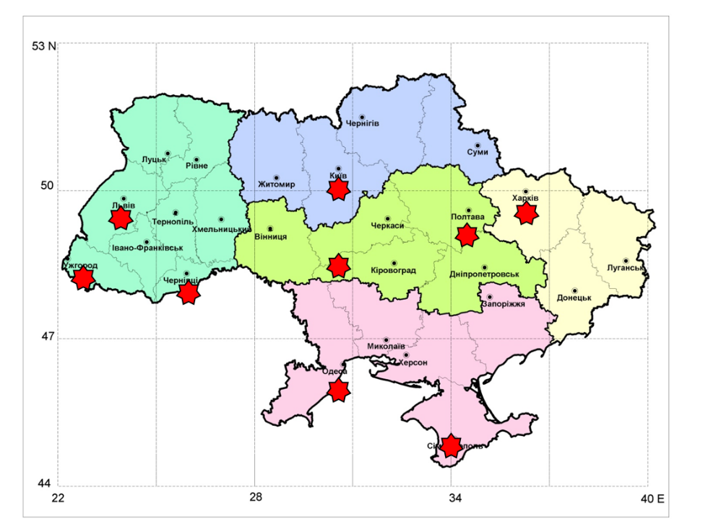
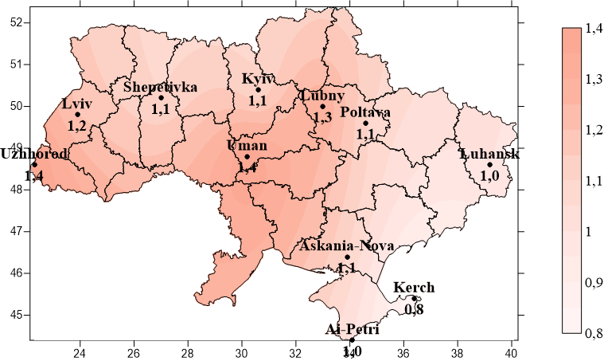
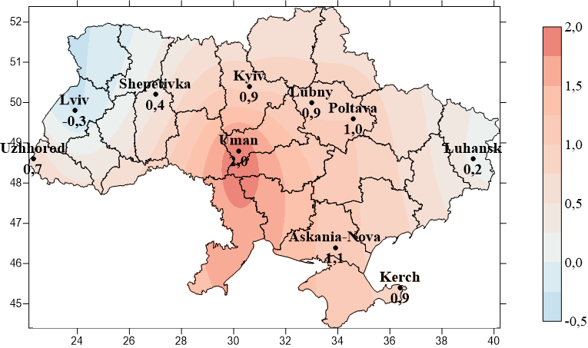
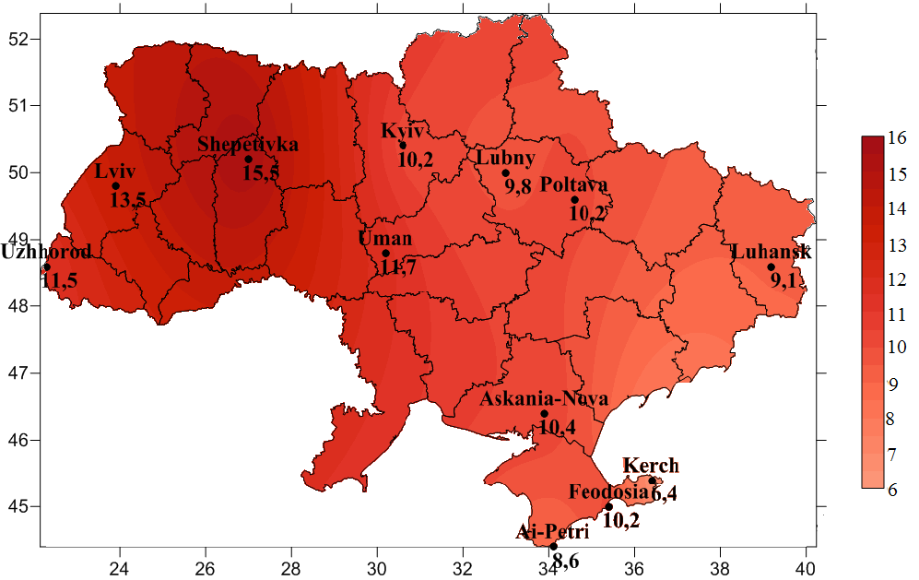
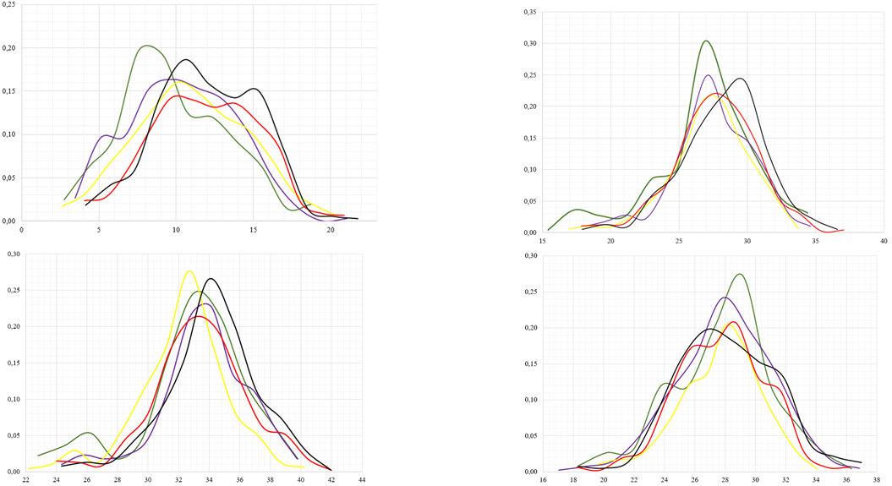
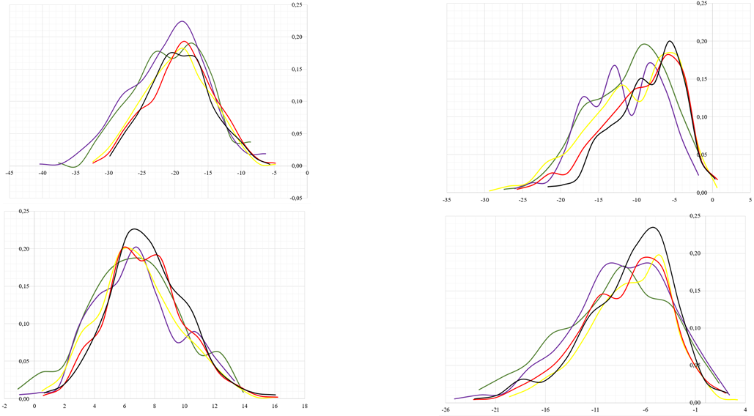
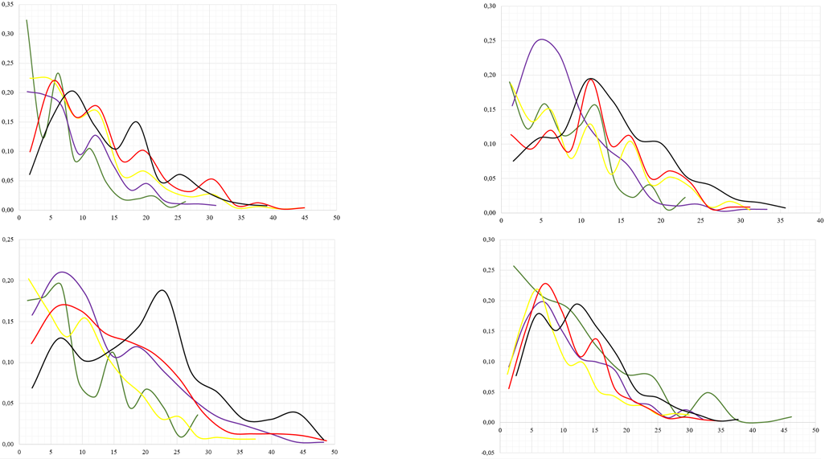
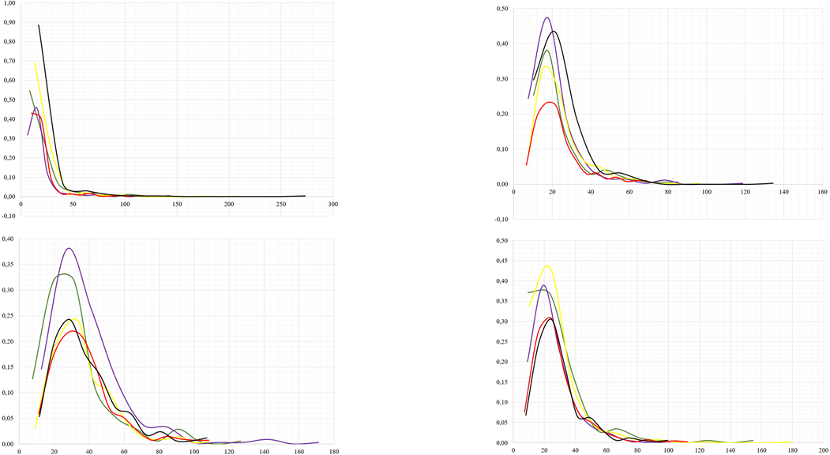
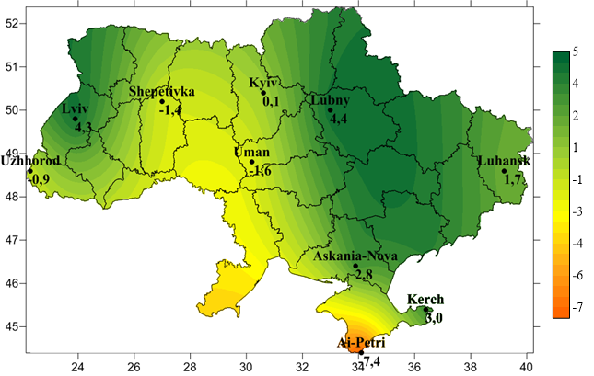
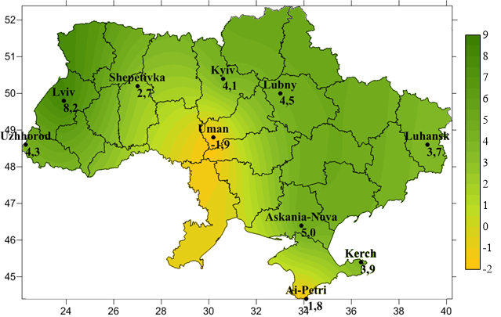
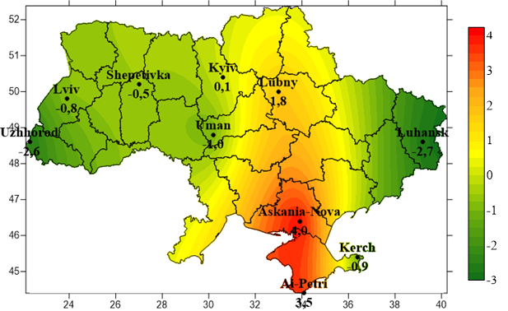
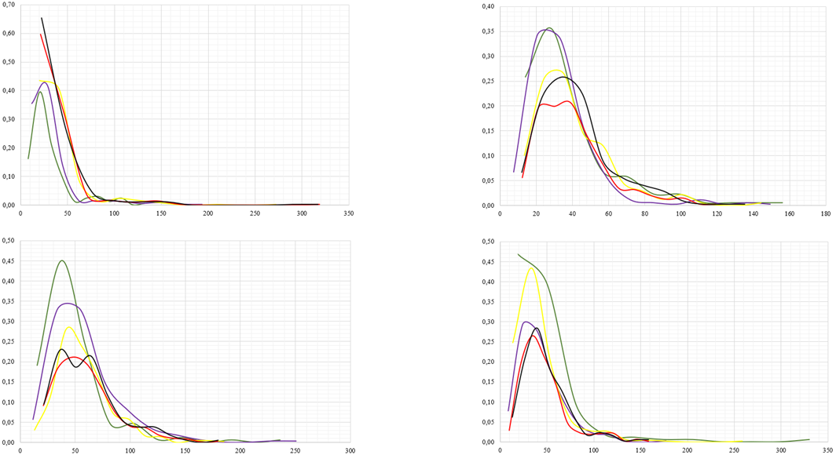
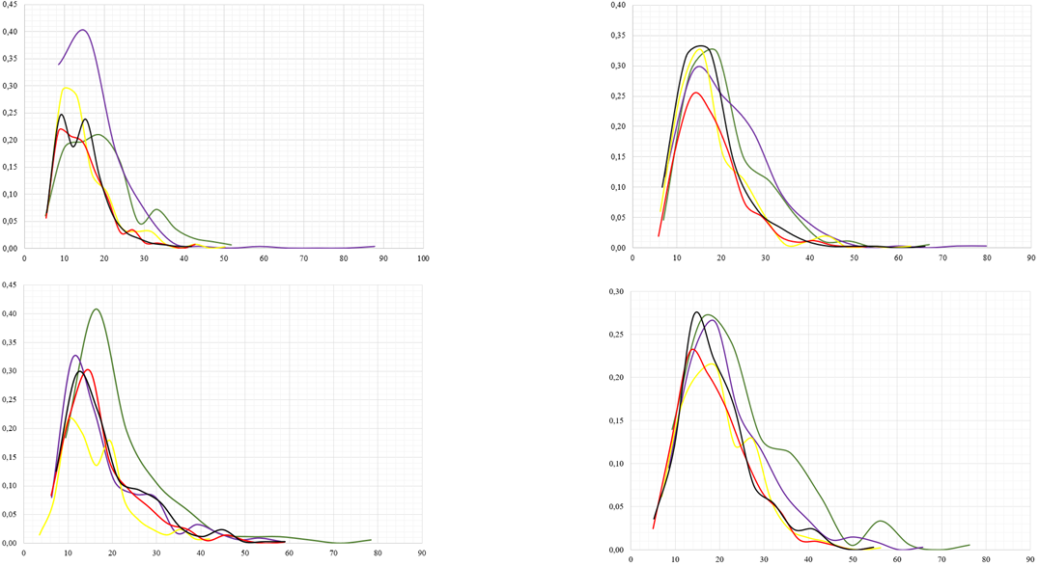
Characteristics of Extreme Temperature and Precipitation in Ukraine Based on ETCCDI Indices
Anna Bohushenko, PhD stud., Sergiy Stepanenko, Prof., Sc.D., and Inna Khomenko, PhD
Odessa State Environmental University, Odesa, Ukraine (ann.bogushenko@gmail.com)
Introduction
Global warming has been accelerating and intensifying the water cycle of the world and increasing the probability of occurrence of global abnormal extreme weather and climatic events, such as high temperature, heat waves, floods, hail, droughts, violent storms. Important indicators of the state and changes in the climate system are climate indices. The joint CCl/CLIVAR/JCOMM Expert Team on Climate Change Detection and Indices (ETCCDI) developed a suite of climate change indices primarily focusing on extremes. Revealing the current and future trends of extreme indices helps to determine ways to climate change adaptation.
Modern changes in the spatio-temporal distribution of precipitation and temperature indices on the territory of Ukraine
The analysis of the spatial distribution of trend of precipitation and temperature indices showed that there are large differences between regions of Ukraine, and coherence of spatial distribution of trends of various indices is low.
Changes in the spatial distribution of the annual maximum temperature from 1961 to 2010 demonstrate a steady increase in values ​​for the entire territory of Ukraine. The spatial distribution shows that the largest increase in temperature occurs in the central regions of Ukraine, spreading from southwest to northeast. The lowest annual absolute maximum temperatures increase in the southern regions, in the east and northwest of the country.
The spatial distribution of changes in the TNn index is characterized by the largest increase in the southwest of the absolute minimum. The spatial distribution of deviations of the index shows that the absolute minimum temperature for the period 1981-2010 compared to the standard climatic period decreased in Lviv. In other cities there is a rise in temperature with the center of the highest growth rates in Uman. These trends coincide with changes in the absolute maximum temperature.
The largest increase in maximum temperature during warm days occurs in the west. The spatial distribution of deviations of the average values of the TX90p index for the period 1981 - 2010 from the climatic norm shows an almost uniform increase in the number of days for the whole territory of Ukraine with a maximum in the western region.
For the whole territory of Ukraine there is a sharp decrease in the number of days when extreme temperatures are higher than the 90th percentile.
Although for the whole of Ukraine there was an increase in extreme rainfall over time in the spatial distribution of changes are not uniform. Analyzing the spatial distribution, we can see that for the RX1day index over time, extreme precipitation increases the most in the eastern and western regions, but in the west the maximum is local. From south-southeast to north-northwest in Ukraine there is a decrease in extreme rainfall, which by the way corresponds to the average rainfall in Ukraine and may be due to the fact that this region receives less rainfall than other regions.
In contrast to the RX1day index, for which there was a significant reduction in extreme rainfall for Art. Shepetivka, Uman and Ai-Petri, for the RX5day index such trends persist for Art. Uman and Ai-Petri, and the reduction is not so intense. For other cities, there is a significant increase in the maximum five-day precipitation per year compared to the standard climatic period, especially for the city of Lviv.
In the spatial distribution of the CDD we can see growth in some parts of Ukraine. In the spatial distribution of the CDD index, the band that extends from the southern regions to the central and northern regions of Ukraine and in which the most arid conditions are formed is sharply distinguished. All other regions are characterized by a decrease in the duration, intensity and frequency of droughts.
Forecast of index values until 2050
According to all calculations, the temperature will rise significantly in the coming years: by about 1 ° C in 32 years. However, it is clear that the trend never lasts indefinitely, but rather is part of the fluctuations with periods, the duration of which is associated with the observation period. Therefore, the trend can stop at any time. But if previous trends continue, Ukraine will face significant warming even compared to modern years.
The amount of precipitation in the coming years will increase at all stations in Ukraine, and if the trends continue, in some cities the amount of precipitation may increase by 50 - 100 mm - these are Kyiv, Lubny, Luhansk.
Spectral analysis and harmonic regression techniques were used to derive simulated and predicted (2019-2050) values of annual precipitation and annual mean temperature and four indices such as maximum value of daily maximum temperature, minimum value of daily minimum temperature, the highest 1-day precipitation amount and maximum number of consecutive dry days for some stations such as Kerch (the Crimean Peninsula), Kyiv (situated in north-central Ukraine along the Dnieper River), Lubny (Dnieper Lowland), Lviv and Shepetivka (Podillia Upland), Uzhhorod (Transcarpathia), Uman (Dnieper Upland).
Annual mean temperature and maximum value of daily maximum temperature were predicted to increase by 0.33°C per decade in the period of 2019-2050 with respect to 1981-2018, while minimum value of daily minimum temperature was predicted to grow slightly faster (by 0.43-0.63ºC per decade).
Precipitation was predicted to increase for the stations in question by 20-66 mm up to 2050 relative to 1981-2018 and conversely maximum number of consecutive dry days will slightly decline except Lubny where increase in an aridity index was predicted. In the next three decades changes in maximum daily precipitation will be various: in Shepetivka and Kyiv such precipitation will be decreased and in other stations increasement in such precipitation will be up to 6 mm till 2050 with respect to 1981-2018. The CDD index is characterized by negative linear trends for all stations in Ukraine, except Lubny, which indicate a decrease in the maximum number of consecutive days with precipitation <1 mm over time for 8-10 days. Over the next 22 years, the aridity index at these stations will continue to decline and trends will intensify. In Lubny, on the other hand, the aridity index should increase by 2050, but only by 2 days. These results are quite consistent with changes in the empirical distribution over time.
Study area and data
This study examines the trends and variations in 6 ETCCDI indices of daily extreme temperature and precipitation, namely annual and seasonal maxima value of daily maximum temperature (TXx), minima value of daily minimum temperature (TNn), number of days when daily maximum temperature >90th percentile (TX90p), maximum 1-day precipitation (RX1day), maximum consecutive 5-day precipitation (RX5day), maximum number of consecutive days when precipitation <1 mm (CDD), for 16 weather stations of Ukraine for all time periods where observations are available. The indices were retrieved from http://www.ecad.eu/.
Station | Observation period
Ai Petri | 1896-2018
Askania Nova | 1910-2015
Vinnytsia | 1936-2008
Kerch | 1936-2018
Kyiv | 1881-2018
Lubny | 1936-2018
Luhansk | 1900-2013
Lviv | 1921-2018
Station | Observation period
Mykolaiv | 1900-2015
Odesa | 1894-2008
Poltava | 1900-2018
Uzhhorod | 1947-2018
Uman | 1886-2018
Feodosia | 1881-2012
Chernivtsi | 1945-2008
Shepetivka | 1936-2018
TXx
TNn
Winter
Spring
Winter
Spring
Summer
Autumn
Summer
Autumn
TX90p
RX1Day
Spatial distribution of deviations of average values of annual maxima of daily maximum temperature (TXx) for the period 1981 - 2010 from the climatic norm
Spatial distribution of deviations of average values of annual minima of daily minimum temperature (TNn) for the period 1981 - 2010 from the climatic norm
Spatial distribution of deviations of the average values of the annual number of warm days (TX90p) for the period 1981 - 2010 from the climatic norm
Winter
Spring
Winter
Spring
Conclusions
In this work, a linear regression model, Mann-Kendall test, spectral and harmonic analysis methods for time series of average annual temperature, annual absolute maximum and annual absolute minimum temperature were used to identify space-time trends in Ukraine and draw conclusions about temperature changes in future.
The TNn index changes the fastest in Ukraine, especially in spring. The number of abnormally warm days increases the fastest in summer and according to constant trends, the number of such days will be almost 50%.. Extreme five-day precipitation intensifies in spring and winter for all stations. The CDD index does not change significantly.
Annual temperature was predicted to increase in the study area, with an increasing rate of 0.3-0.5°C decade−1 in the next 30 years. Most increase in temperature was predicted for the Crimean Peninsula. Increasing rate of maxima value of daily maximum temperature is the same. Minima value of daily minimum temperature was predicted to increase the most from 0.44 to 0.62°C decade−1. Seasonal values of all indices were predicted to grow, especially in summer and winter for TXx and in spring for TNn.
Precipitation is predicted to increase in range of 4 to 22 mm decade−1, the most increasing rate will be observed in stations located in the western and central parts of Ukraine. For the period of 2019-2050 for the most of the territory of Ukraine time series of annual and seasonal RX1day showed slightly increasing trends while the annual and seasonal CDD is anticipated to decrease insignificantly.
In contrast to the RX1Day index for a RX5Day for almost the entire territory of Ukraine, except for the south-western regions, such precipitation is increasing, although the absolute maximum recorded in 1901-1930 was not exceeded.
Summer
Autumn
Summer
Autumn
RX5Day
CDD
Winter
Spring
Winter
Spring
Spatial distribution of deviations of average values of annual maximum one-day precipitation amount for the period 1981 - 2010 from the climatic norm
Spatial distribution of deviations of average values of annual maximum five-day precipitation amount for the period 1981 - 2010 from the climatic norm
Spatial distribution of deviations of average values of annual consecutive dry days) for the period 1981 - 2010 from the climatic norm
Summer
Autumn
Summer
Autumn
Spatially distributed trends
For the weather stations where observations are available up to 2018 Mann-Kendal trend method and the Sen’s slope method were applied to examine the climate variability for the period of 1945–2018. Spatially distributed trends of all indices are obtained in the study area for every season for the period of 1945-2018. In Ukraine, approximately 96% of the time series of TXx and TX90p and 100% of time series of TNn showed increasing trends. Among extreme precipitation indices, 90% of the total time series disclosed strong evidence of increasing RX1day and RX5day over the whole study area in all seasons, except in the South of Ukraine where there is a decrease in these indices in summer. All trend lines of CDD show downward trends in all seasons over most of the area in question, except summer where a slight increase in CDD is observed over the whole territory of Ukraine.
Empirical distribution of probabilities of seasonal values of indices
Empirical probability distributions of annual and seasonal indices based on data from 16 stations are obtained for the whole available time period. For Ukraine average, all annual extreme temperature indices grow strongly in the period of 1991-2018. Seasonal temperature indices also increase but change in distribution differs among seasons. The warming amplitude in TXx were higher in winter and summer than in spring and autumn. The TNn averaged over Ukraine the most intensively increase in spring than in other seasons. The TX90p significantly grows in spring from 24 in the beginning of the 20th century to 37 such days in the period of 1991-2018, though in other seasons warm days may be far greater (up to 45-50).
Maximum 1-day precipitation and maximum 5-day precipitation averaged over Ukraine show increasing trends in the period of 1991-2018. But in seasons RX1day and RX5day increase only in winter and spring, but in other seasons they decrease. The annual and seasonal CDD has been decreasing since
the early 1960s.
Seasonal changes in the spatio-temporal distribution of indices
For the TXx, the changes in spring and autumn are the smallest and do not exceed 0.02 ℃ per year. In spring, the temperature rises more rapidly in the western and southern regions, and in autumn - only in the south. In winter and summer, the temperature change is much higher to 0.06 ℃ per year, which means that in 2050 compared to 1945 the temperature will increase by 6 ℃. The fastest changes in the TNn occur in the spring. In the northern, central and southern regions, the temperature rise reaches 0.08 ℃ per year, which will thus lead to an average temperature increase of 8 ℃ by 2050 with constant trends. In winter, the rate of temperature increase does not exceed 0.05 ℃ per year (the largest changes are observed in the central regions), and in summer and autumn - even less. The TX90p grows fastest in summer, especially in the south, where the increase in such days is 2-3 days per decade and according to constant trends, the number of such days will be almost 50%.
Trends obtained for the RX1Day are significant for the northern, central and western regions of Ukraine. Although winter, spring and autumn trends are increasing, but such precipitation has increased slightly since 1945 - a maximum of 1 mm per decade and occurs in mountainous areas. The greatest increase in RX5Day occurs in winter and spring at all stations for which the forecast was made.
In winter and autumn there is a significant decrease in the CDD for all stations, except Lubny. In summer, the CDD at all stations increases slightly.

